Slide 1
Scaling the Heights of Education:
Balanced Personal and Professional Development & Performance
Professor Kimathi Kigatiira
Dean, Medical School
Mount Kenya University
AMCO Conference, Sarova White Sands Resort & Spa
Mombasa, 31 Aug – 4 Sept 2015

Slide 2
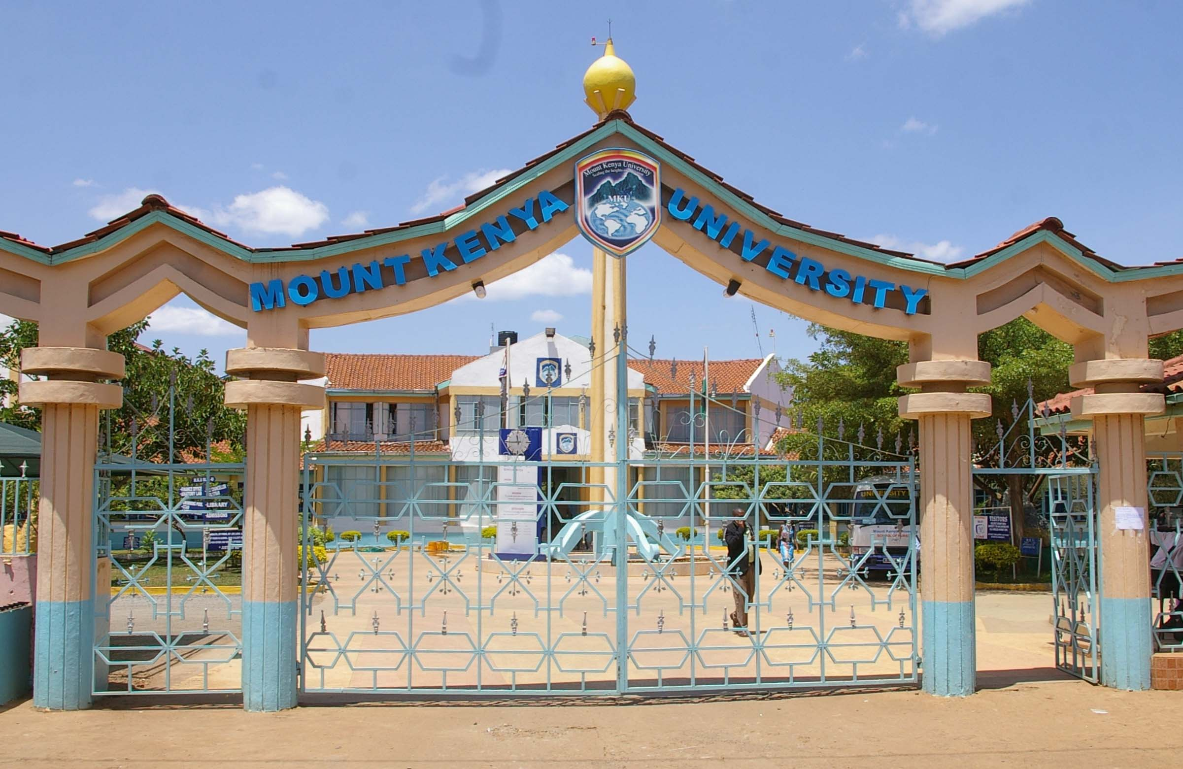
SCAILING THE HEIGHTS OF EDUCATION
UNIVERSITY MAIN GATE

Slide 3
Quotes - Youth
“Don't laugh at a youth for his affectations; he is only trying on a face after another to find his own.”
Logan Pearsall Smith (1865 - 1946)
“Nothing can be so amusingly arrogant as a young man who has just discovered an old idea and thinks it is his own.”
Sidney J. Harris
“In youth we learn; in age we understand.”
Marie Ebner von Eschenbach

Slide 4
What is Education?
“A purposive,conscious or otherwise, psychosocial, philosophical and scientific process, which bring about development of the individual and society to the fullest extent in such a way that both enjoy maximum happiness and prosperity”
“Education is development of individual according to his needs and demands of society, of which he is an integral part” Satish Kumar and Sajjad Ahmad

Slide 5
How do we achieve this in medical education
MENTORSHIP
William A. Ward has said,
"The mediocre teacher tells.
The good teacher explains.
The superior teacher demonstrates.
The great teacher inspires.
- Progress Magazine, December 23, 1992.
But take note:
Only one Teacher Sacrificed for His students – Jesus Christ, our Lord and Saviour

Slide 6
Education is Key to Transformation and Positioning for Excellence
8. Doctoral Degree
7. Master’s Degree
Transformative Education or
“Scaling the Heights of Education”
6. Bachelor’s Degree
5. Professional Diploma
4. Professional Certificate
3. Secondary School Education
2. Primary School Education
1. Early Childhood Development

Slide 7
Education is Key to Transformation and Positioning for Excellence
5. Discover
4. Synthesize
Transformative Education or
“Scaling the Heights of Education”
3. Deduct and Induct
2. Compare and Contrast
1. Recognize, Describe, Define
Evidence-generation and knowledge management is key to transformation and positioning for excellence

Slide 8
Education is Key to Transformation and Positioning for Excellence
5. Application
4. Wisdom
Transformative Education or
“Scaling the Heights of Education”
3. Knowledge
2. Information
1. Data
Facts based on observations : Data. Adding meaning to data: Information . Comparing meaning to what is already known: Knowledge . Lesson learned from the application of knowledge: Wisdom. Decisions, options, choices made based on data, information, knowledge and wisdom: Application.

Slide 9
Education is Key to Transformation and Positioning for Excellence
5. Values
4. Education
Transformative Education or
“Scaling the Heights of Education”
3. Fairness & Justice
2. Social interactions
1. Resources
Our values and guiding principles, education, perceived fairness or justice of affairs, social interactions and resources guides transformation and positioning for excellence

Slide 10
Godly Education + Godly Beliefs + Godly Actions = Godly Transformation and Godly Positioning for Godly Excellence
5. Beliefs: Self, Others, God
4. Thoughts: Self, Others, God
Godly Transformative Education or
“Scaling the Heights of Education”
3. Feelings: Self, Others, God
2. Words: Self, Others, God
1. Actions: Self, Others, God
This is the power of suicide bombers, including Samson in Bible. “Faith without action is death.” Beliefs without actions leads to no progress.

Slide 11
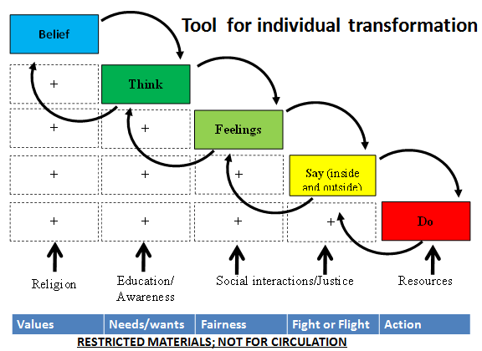
The power of belief and religion results in dramatic personal and professional transformation. This goes beyond development and performance. It may result in self-sacrifice

Slide 12
Education is Key to Transformation and Positioning for Excellence
5. Global/United Nations
4. Nation/State
Transformative Education or
“Scaling the Heights of Education”
2. Community
1. Family
Meeting aspirations, concerns and commitments commensurate to age and responsibility in a given setting and position in the world. Thinking globally and acting locally.

Slide 13
Education is Key to Transformation and Positioning for Excellence achievable through proper mentorship
5. Evaluate
4. Experience
Transformative Education or
“Scaling the Heights of Education”
3. Demonstrate
2. Explain
1. Tell
Evidence-generation and knowledge management is key to transformation and positioning for
Notes:
All eleven business domains are transformative in getting the best out of individuals, families, communities, settings, organizations, institutions, societies, nations and world. (22 March 2015)

Slide 14
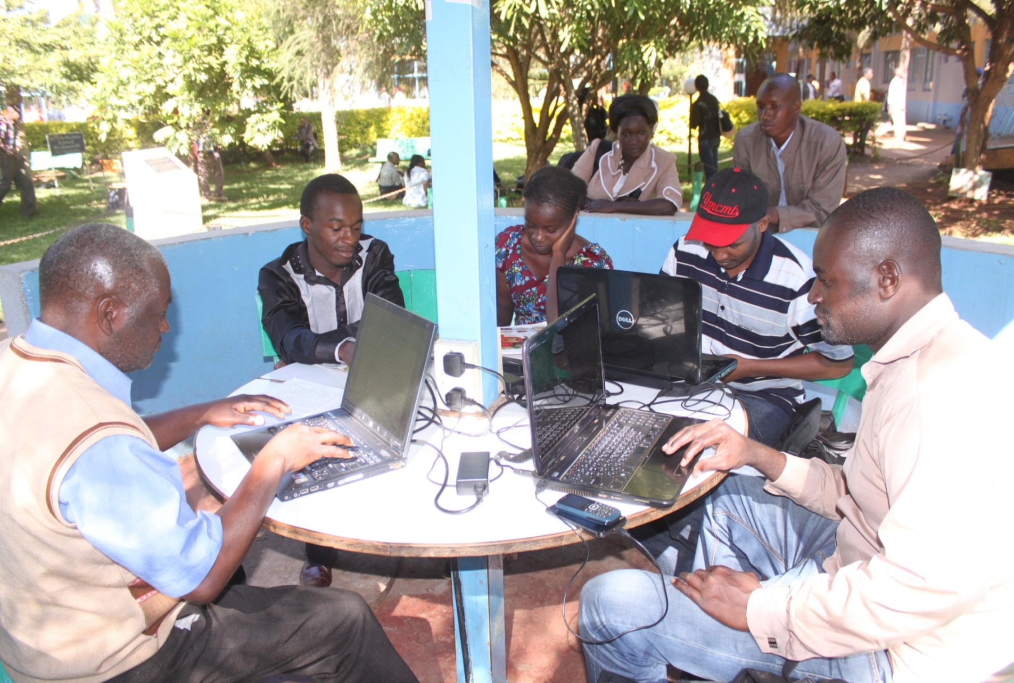
Study Villas Wi-Fi Enabled

Slide 15
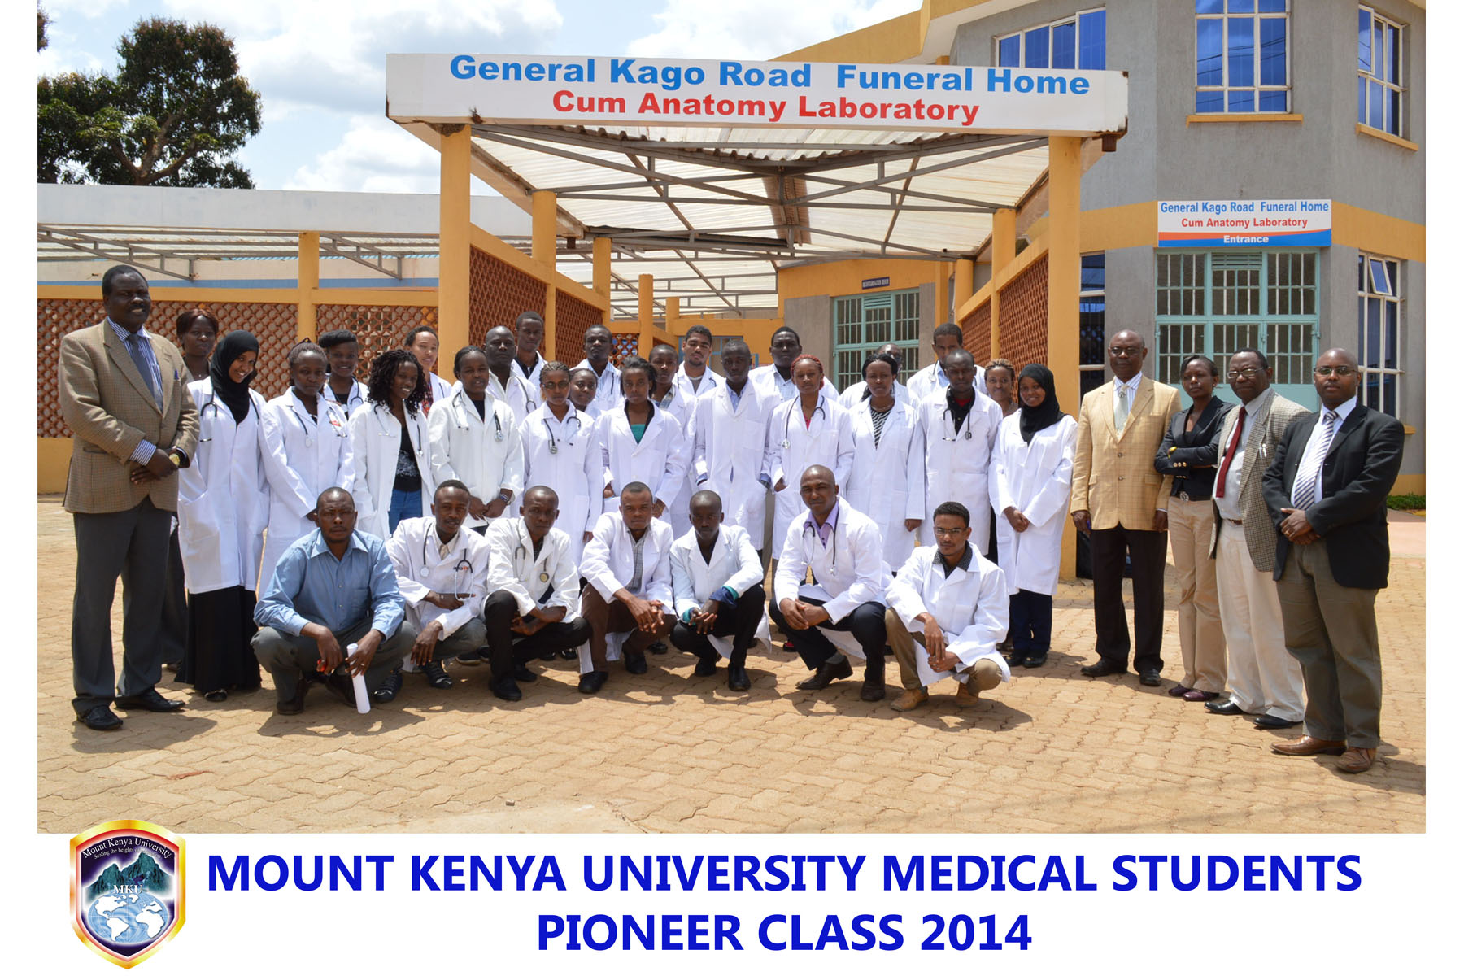

Slide 16
In summary, What is transformative Education?
Knowledge of good and progressive social behavior
To be educated is to “Think Globally and Acting Locally”

Slide 17


THE END
GOD BLESS

